Slide 1


Intro to Linux
Houriiyah Tegally

Slide 2

Other ways to access Linux on Windows
Virtual Box
Creating a Ubuntu VM (virtual machine)
https://www.wikihow.com/Install-Ubuntu-on-VirtualBox
Ubuntu App on Windows 10

Slide 3
Windows 10 Installation (after downloading Ubuntu App)
1. Open Powershell
2. Type in the command below:
wsl --install

Slide 4
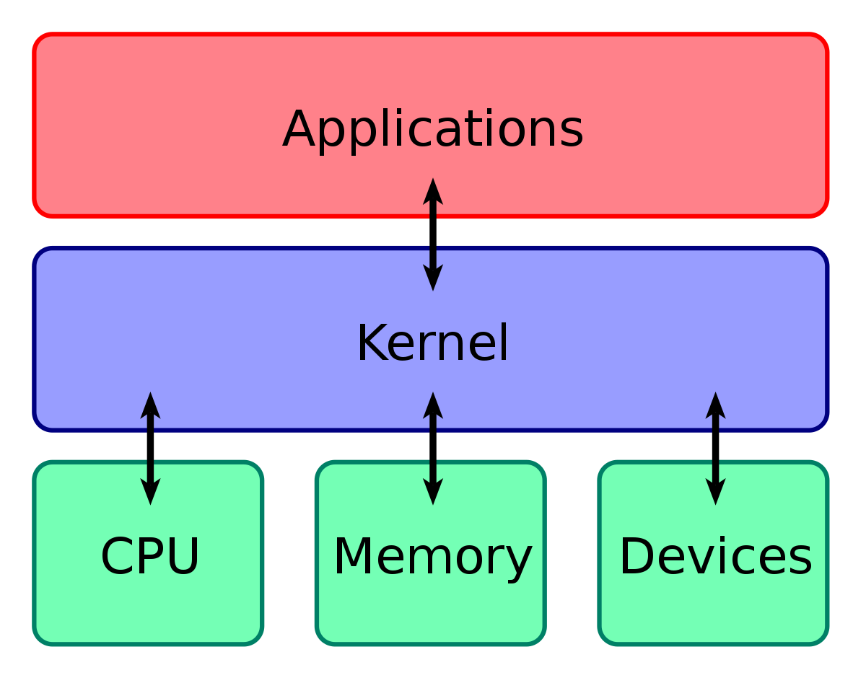
What is Linux?
Unix released by AT&T’s Bell Labs in early 1970s.
Unix was portable to many platforms.
Richard Stallman and Linus Torvald created an open-source alternative, with a kernel called Linux, in the 1990s.
Linux kernel is extremely common in data servers, phones, cars, TVs, and more.
Notes:
Ken Thompson and Dennis Ritchie, two programmers at AT&T’s Bell Labs in the 1970s, designed an operating system using C language that they called Unix.
Unlike previous operating systems that were tied closely to the hardware, Unix was portable to many platforms and is the mother of modern OSes.
Richard Stallman and Linus Torvald created an open-source alternative, with a kernel called Linux, in the 1990s. Users created many distributions – the most popular today is Ubuntu.
Linux is extremely common in data servers, phones, cars, TVs, and more. It is more accessible, free of licensing restrictions common to Unix, and it also has one kernel. Device drivers will usually work on any distribution.
Image: This altogether is an operating system. Unix is one whole example, whereas Linux is just the common kernel. It is packaged into distros.

Slide 5

What is Ubuntu?
You may know what the word means…
Free and open-source Linux distro, based on Debian deb packages (Ubuntu Software)
Commercial support provided by Canonical Ltd
Default installation “application-light”, build/install as and when necessary
Limited user privileges prevent corruption of OS or user-specific files
Require superuser (sudo) privileges to access kernel/root
Notes:
In Windows 10, can install Ubuntu directly on to computer, thanks to WSL – Windows Subsystem for Linux. Shows Linux’s influence!
Before windows 10, the most common method was to install VirtualBox to virtually create another computer within a computer. Still popular!

Slide 6
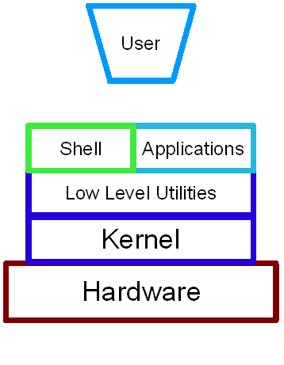
The command line
A user interface that is navigated by typing commands at prompts, instead of using the mouse.
Also referred to as cmd, CLI, prompt, console or terminal.
The default shell for most Linux distributions is GNU Bash.
Mac (terminal): Applications->Utilities
Linux (terminal): Applications->Utilities
Windows: search Command Prompt or Windows+R, cmd

Slide 7
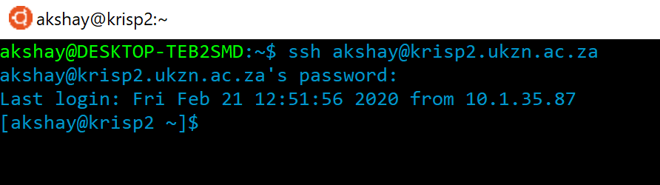
Ubuntu terminal
Computer name
Secure shell (ssh)
to access server
Computer user
Server user
Server
Brackets indicate remote access
~ is current directory
Prompt

Slide 8
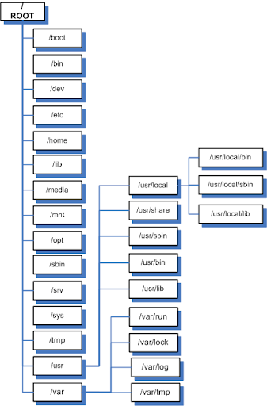
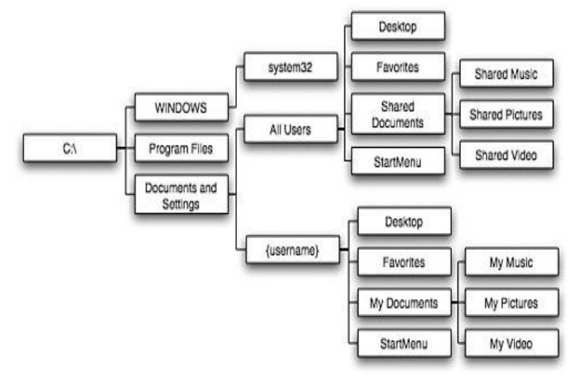
Ubuntu directory
Root directory = /
Home directory = ~
Current directory = .
Previous directory = ..
Windows directory, for reference:

Slide 9

Path
Path to file = location of file in file system
Determined by hierarchy of directory tree
In Ubuntu, delimiter = /
e.g. ~/Documents/Project2/File7.pptx
In Windows, delimiter = \
e.g. C:\Users\Akshay\Documents\Project4\File3.pptx
Distinguish between absolute and relative path
Not to be confused with $PATH

Slide 10
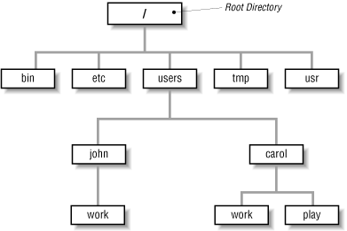
Path practice
Absolute (full) path = path from root (/) to file/directory location
Does not change, regardless of current directory
Relative path = path to file/directory in relation to current directory
Depends entirely on directory structure

Slide 11
Commands, options, arguments
argument
command
mkdir -v ~/Documents/Project1/
Option (flag)

Slide 12
Tips
Always be sure where you are, i.e. your current directory
Where you are will determine how you can move
Know which is a directory and which a file
Everything is case-sensitive
Spaces are both necessary and a mistake
Tab completion is your friend
Know which is the command, which is the option (if there are any), and which is the argument
Use clear command to clean up your terminal window when things are getting too messy. This will not change which directory you are in.
Notes:
Tab completion…

Slide 13
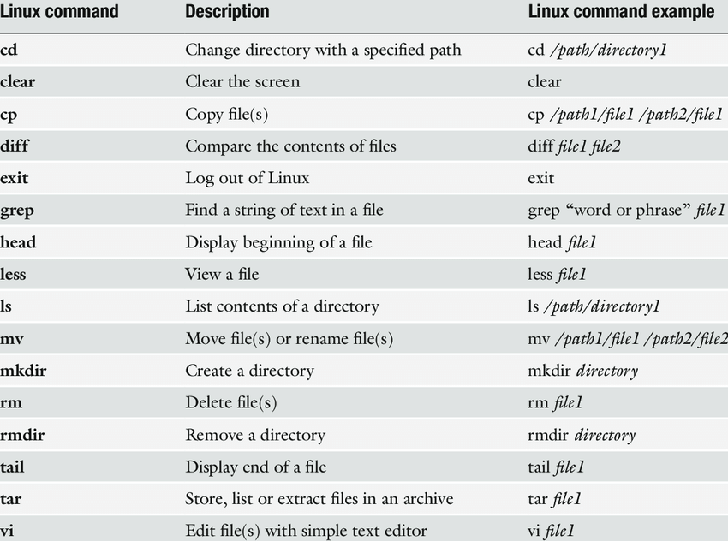
Commands
Navigating between directories
Print working directory (pwd)
List (ls)
Change directory (cd)
Manipulating files and directories
Make directory (mkdir)
Create new, empty file (touch)
Move (mv)
Copy (cp)
Secure copy (scp)
Remove (rm)
THERE IS NO UNDO!

Slide 14
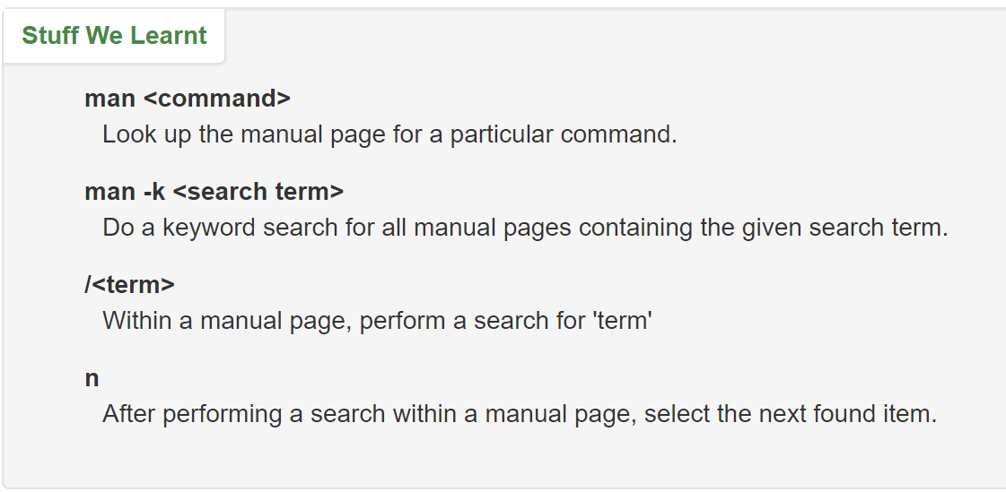
Manual pages – practice with ls

Slide 15
Activities
Use the commands cd and ls to explore what directories are on your system and what's in them. Make sure you use a variety of relative and absolute paths. Interesting places:
/etc - Stores config files for the system.
/var/log - Stores log files for various system programs. (You may not have permission to look at everything in this directory. Don't let that stop you exploring though. A few error messages never hurt anyone.)
/bin - The location of several commonly used programs (some of which we will learn about in the rest of this tutorial.
/usr/bin - Another location for programs on the system.
Now go to your home directory using 4 different methods.
Make sure you are using Tab Completion when typing out your paths too.

Slide 16
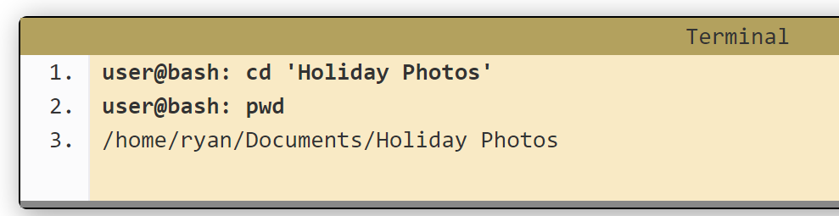
File tips
Linux is case-sensitive.
Linux allows spaces in file names, but command line recognizes spaces to separate items. To get around this, use single quotes.
Use the command basename <file> to separate the filename from the full file pat
You can use the wc –w <filename> command to count words in a file, or wc –l <filename> option to count lines.
Linux is extensionless.
Your files in Windows and Mac may end in .pdf or .jpeg and the files may not open without them.
These extensions will show up in Linux as well, but they’re not necessary. Linux treats all files the same.

Slide 17
wc command
wc [OPTION] [FILE]
OPTIONS:
-l : number of lines
-w : number of words
-c : count of bytes
-m : number of characters
But how do we print only the count number without the file name?
We can make use input command
wc [OPTION] < [FILE]

Slide 18
Your turn!
Start by creating a directory in your home directory in which to experiment.
In that directory, create a series of files and directories (and files and directories in those directories).
Now rename a few of those files and directories.
Delete one of the directories that has other files and directories in them.
Move back to your home directory and from there copy a file from one of your subdirectories into the initial directory you created.
Now move that file back into another directory.
Next, move a file and rename it in the process.
Count the number of lines and words in a few files

Slide 19
COFFEE BREAK!

Slide 20
Vi text editor
Vi is the default command line text editor in Ubuntu. Like Windows’s Notepad or Mac’s Textedit.
It’s command line, meaning no mouse! Keyboard only.
Two modes: Command and Insert
Open a file (or create one) with vi <filename> command

Slide 21
Vi text editor

Slide 22
Vi text editor
Let’s try!
Create a file <text_file.txt>
vi text_file.txt
Edit the file
press ‘i’
start typing…
Save and close the file
press ESC
press ‘:’ , ‘w’ , ENTER
press ‘:’ , ‘q’ , ENTER
Reopen the file
vi text_file.txt
Edit the file
press ‘i’
start typing…

Slide 23
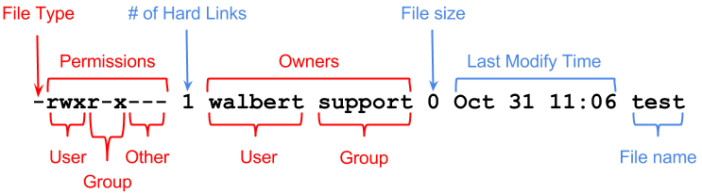
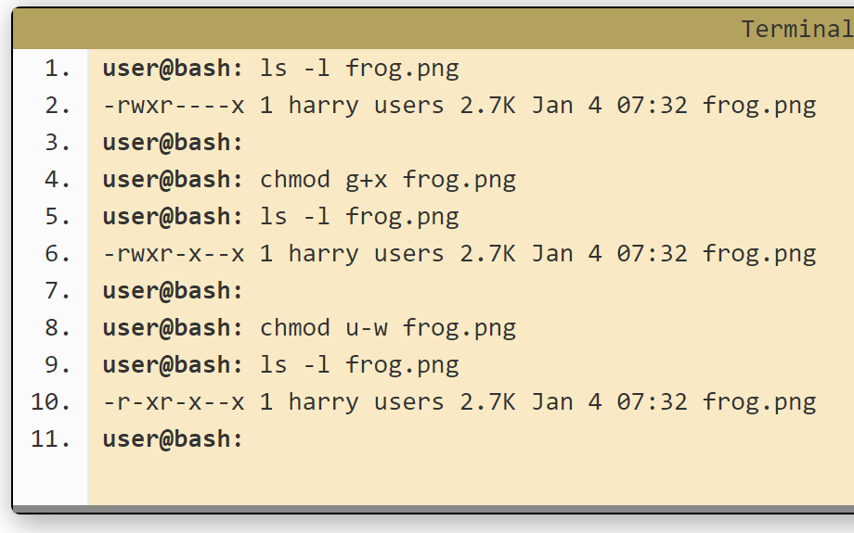
Permissions (ls -l)… practice on Hello World
Change permission using command:
chmod <options> <file>
Who are we changing the permission for? [ugoa] - user (or owner), group, others, all
Are we granting or revoking the permission - indicated with either a plus ( + ) or minus ( - )
Which permission are we setting? - read ( r ), write ( w ) or execute ( x )

Slide 24
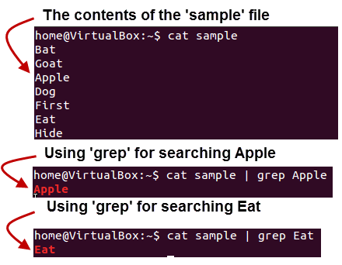
Pipe & Redirect
The Pipe is a command in Linux that lets you use two or more commands at the same time and runs them consecutively.
The output of each command serves as the input for the next command.
The symbol '|' denotes a pipe.
The Redirect command lets you write the output of a command to a file instead of on the command line
The symbol ‘>’ denotes a redirect
Eg: grep “gene” file1.txt > file2.txt
This will search for the number of pattern “gene” and create a file containing this pattern
Using ‘>>’ helps you to append your output to

Slide 25
Pipe & Redirect
Let’s try!
Go to your terminal. Navigate to Sample_Files directory.
Count the number of words or lines from some files but direct the output to a specified output file
Display the contents of a file and count the number of words displayed in one command

Slide 26
Wildcards in Linux
Wildcards are symbols or special characters that represent other characters.
They can be used with any command such as ls or rm to list or remove files matching a given criteria, without having to manually list all the files.
* - matches one or more occurrences of any character
? - matches a single occurrence of any character
[ ] - matches any occurrence of character enclosed in the square brackets

Slide 27
Wildcards in Linux
ls l*
listopen.sh
list.sh
lost.sh
lspace.sh
ls l?st.sh
list.sh
lost.sh
ls l[aeiou]st.sh
list.sh
lost.sh

Slide 28
Wildcards in Linux
ls ??st*
listopen.sh
list.sh
lost.sh
ls [clst]*
createbackup.sh
listopen.sh
list.sh
lost.sh
lspace.sh
ls *op*
listopen.sh
topprocs.sh

Slide 29
Wildcards in Linux
Let’s try!
Go to your terminal. Navigate to Sample_Files directory
List all files that contain the word ‘file’ in their name
Remove all files that contain the ‘.zip’ extension
Copy all executable files (that end in ‘.sh’) to a different directory

Slide 30
Regular expressions
Regular expressions are a powerful means for pattern matching and string parsing that can be applied in so many instances. Regular expression allow us to:
Validate text input
Search (and replace) text within a file
Batch rename files
Undertake incredibly powerful searches for files
Interact with servers like Apache
Test for patterns within strings
But, can be confusing at first!

Slide 31
Regular expressions
RegEx
Literal characters
Metacharacters
Standard characters like we know them
Special characters that give regular expressions their power

Slide 32
Regular expressions - regex
Examples of regular expression construction for pattern searching […]:
‘^W’ : Match any string which starts with W
‘n$’ : Match any string which ends with n
‘^[NW]’ : Match any string which starts with N or W
‘[NW]’ : Match any string with N or W, not restricting to first character
‘Walt|Jack’ : Match all entries which contain Walk or Jack
‘^[W]…..’ : Match any string which start with W and is followed by only 5 characters

Slide 33
Regular expressions - regex
Can you guess what these do?
‘^x’ :
‘p$’ :
‘^[abcd]’ :
‘[NW]’ :
‘Apples|Oranges’ :
‘^[O]…...’ :
‘^[AO]*s$’:

Slide 34
Regular expressions - regex
Can you guess what these do?
‘^x’ : Match any string which starts with x
‘p$’ : Match any string which ends with p
‘^[abcd]’ : Match any string which starts with a or b or c or d
‘[AO]’ : Match any string which contains with A or O
‘Apples|Oranges’ : Match any string which contains Apples or Oranges
‘^[O]…...’ : Match any string which starts with O and has exactly 7 characters
‘^[AO]*s$’: Match any string which starts with A or O, and ends with s

Slide 35
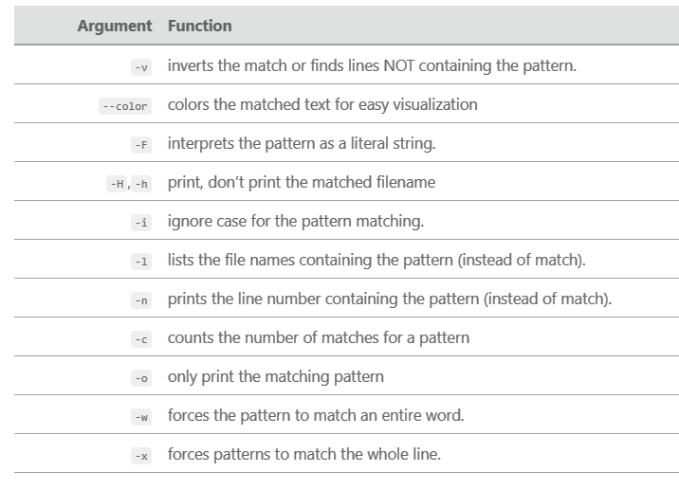
Grep
Grep: grep is a command for searching a string or pattern matching a regular expression.
Eg: grep “my pattern” file.txt
Common grep command:
grep 'word' filename.txt – Search any line that contains the word in filename.
grep -i 'bar' file1 – A case-insensitive search for the word ‘bar’ in file1.
grep -R 'foo' . – Search all files in the current directory and in subdirectories for word ‘foo’
grep -c ‘Gene’ file1 – Search and display the total number of times that the string ‘Gene’ appears in file1

Slide 36
Grep
Examples:
Go to your terminal: Navigate to Sample_Files directory
grep ‘moon’ file3.txt
grep –i ‘moon’ file3.txt
grep –vi ‘moon|earth’ file3.txt
grep –i ‘earth’ > file4.txt
grep –ci ‘earth’ file3.txt
grep –n ‘earth’ file3.txt

Slide 37
Grep
Examples:
Go to your terminal: Navigate to Sample_Files directory
From file5.txt
Look for all food additives which are preservatives
Look for all compounds which are natural
Save all food compounds which are not associated to sugar or salt in a separate file
Count how many food additives are associated with salt

Slide 38
Sed
Sed: sed command is used to replace the text in a file. Sed accommodates regular expression use.
Eg: grep “my pattern” file.txt
Common grep command:
sed 's/unix/linux/’ file.txt– replace first occurrence of ‘unix’ in each line with ‘linux’
sed 's/unix/linux/2’ file.txt– replace first two occurrences of ‘unix’ in whole file with ‘linux’
sed 's/unix/linux/g’ file.txt . – replace all occurrences of ‘unix’ in whole file with ‘linux’
sed '3 s/unix/linux/g’ file.txt – replace all occurrences of ‘unix’ in third line with ‘linux’
Dealing with strings
String pattern to be replaced
String pattern to replace with
'global’ option
unix is great os. unix is opensource. unix is free os.
learn operating system.
unix linux which one you choose.
unix is easy to learn.unix is a multiuser os.Learn unix .unix is a powerful.

Slide 39
Sed
Examples:
Go to your terminal. Navigate to Sample_Files directory
From file6.txt:
Replace all occurrences of the word ‘rewards’ with ‘benefits’
Replace the first 5 occurrences of ‘people’ with ‘person’
Replace all occurrences of ‘sport’ or ‘activity’ with ‘exercise’
Dealing with strings
String pattern to be replaced
String pattern to replace with
'global’ option

Slide 40
Commands for Bioinformaticians
curl: a tool to download data and text from the web;
grep: a tool to search our data and text;
gawk: a tool to manipulate our data and text;
sed: a tool to edit our data and text;
xargs: a tool to repeat the same step for multiple data items;
cat: a tool to get the content of file/concatenate contents of many files;
tr: a tool to replace one character by another;
sort: a tool to sort multiple lines;
head: a tool to select only the first lines.

Slide 41
curl command
curl is a command-line utility for transferring data from or to a server designed to work without user interaction. With curl, you can download or upload data, resume transfers, limit the bandwidth, proxy support, user authentication, and much more.
curl [options] [URL...]
Options:
-O, -o: To download a file, and save with the original name, or with a new specified name.
curl –O <download link…>
-C : To resume an interrupted download
curl -C - -O <download link…>
-L : instructs curl to follow any redirect until it reaches the final destination
curl -L google.com

Slide 42
sort command
sort command helps in sorting out the contents of a file alphabetically
sort [options] [filename]
Options:
Try it:
Create a text file with a list of words
E.g:
Apples
Oranges
Banana
Grapres
Pineapple
Watermelon
- Sort in alphabetical order and reverse sorting
-r | Reverses sorting
-n | Sorts numerically
-f | Case insensitive sorting

Slide 43
tr command
The tr command is used for translating or deleting characters, supporting a range of transformations including uppercase to lowercase, deleting specific characters and basic find and replace
tr [OPTION] SET1 [SET2]
tr “[a-z]” “[A-Z]” file.txt– Changes all lower case characters to upper case
tr '{}' '()' newfile.txt- Changes all { } brackets to ( ) brackets
tr -d ‘w’ file.txt- Deletes the character w
tr -s [:space:] ‘ ‘ file.txt- Squeezes all empty spaces to a single space
tr -d [:digit:] file.txt- Deletes all digits

Slide 44
Let’s practice with some real data!
First, let’s tidy up your working space!
Make a new directory called old_work
Move all your files from yesterday to that directory
Go back to your home directory

Slide 45
Let’s practice with some real data!
Download data
Use the following command:
curl -L -o Data.zip https://tinyurl.com/KrispLinuxWorkshopData2020
Extract files
unzip Data.zip
Delete zip file
Create a new directory name ‘Data’
Move all sequence files to that new directory
Make a copy of this directory
Rename directory

Slide 46
Let’s practice with some real data!
Go into working directory
View the contents of some files
View the first few lines of some files
Merge sequence files
Search for sequences from South Africa
Now, list only the file names containing sequences from South Africa
Replace all ‘South Africa’ with ‘KZN’
Find files with missing sequence segments
Delete all missing DNA characters (N)

